Slide 1
DEMONSTRATION OF REMOTE-CONTROLLED CANARD WING AIRCRAFT MODEL

Slide 2
AIM OF THE PROJECT:
Our primary aim is to demonstrate the operation of a remote controlled canard aircraft model.
In addition the pressure and attitude difference during the course of the flight is also determined.
The pressure variation over the canard wing is predetermined with the help of the wind tunnel testing.

Slide 3
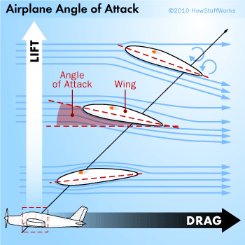
REASON OF PLACING THE CANARD:
Problem in achieving higher angle of attack and manuevering capabilities.
Problem of flow separation at higher angle of attack.
Decrease in the overall efficiency because of the drag.
Eliminating the use of conventional
tailplane thus aiding in the stability.

Slide 4
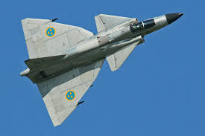
DESIGN AND PURPOSE:
A canard is an arrangement wherein a small forewing or a foreplane is placed forward of the main wing of a fixed-wing aircraft.
Better control of the main wing flow and better manuevering capabilities at high angles of attack and during a stall.
To reduce the main wing loading.

Slide 5
Canard wings being placed ahead of the centre of gravity, directly acts to reduce the longitudinal static stability (pitch stability)
This problem can be resolved by increasing the wing loading of the canard wing.
This in turn increases the lift induced drag which can be solved by using a high aspect ratio wing which will reduce the drag.
This type of canard airfoil has a higher camber as compared to the main wing.

Slide 6
DIMENSIONS:
Distance between the canard wing and the main wing is 45cm
Wing span is 75cm
Canard wing area is 825 sq.cm(31% of the main wing area)
Main wing area is about 2752 sq.cm

Slide 7
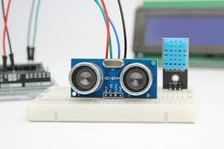
CONSTRUCTION:
Obstacle avoidance sensor hcsro4
is used.
Ultra sonic ranging module sensors is programmed to range between 2cm and 400cm using aurdino. The sensor uses a frequency of 400kHz and it can be altered.
Bluetooth transmitter and receiver is used for the control of the aircraft.

Slide 8
Brushless motors are placed to provide the sufficient thrust. The number of motors to be placed depends on the weight consideration.
CATIA software is being used to design the canard wing to be tested in the wind tunnel.

Slide 9
IMPORTANT PARAMETERS:
The area of the canard is around 20%-40% of the main wing area.
The aspect ratio of the canard should be greater than that of the main wing.
The centre of gravity should be ahead of the main wings.
The wing loading of the canard should be atleast 1.6 to 2 times as that of the main wing in order to increase the pitch stability.

Slide 10
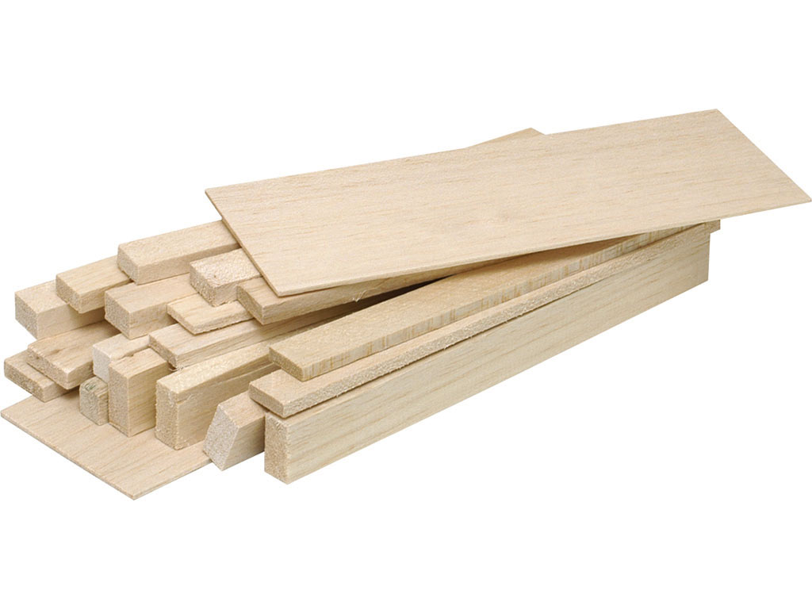
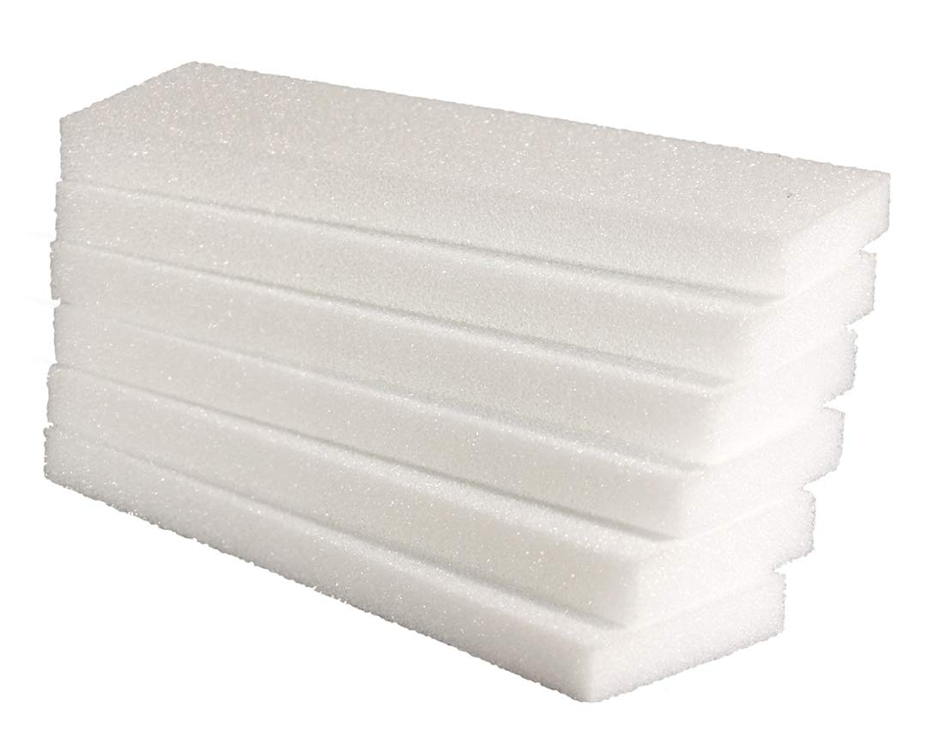
MATERIALS USED:
Fuselage is constructed with balsawood.
Wings are constructed with styrofoam.

Slide 11
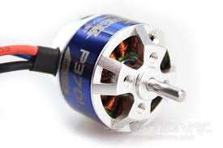
To provide the airfoil shape, the wings are covered with balsawood and tight polythene sheets.
Brushless motors are placed over the wings and at the front for providing thrust.
Electronic circuits, transmitter, receiver and the batteries are placed in the fuselage.

Slide 12
COST OF MATERIALS:
1. | Balsawood(15*15*300) | Rs.2100
2. | Styrofoam(thickness-7cm) | Rs.470/sq.m
3. | Brushless motor | Rs.600
4. | Aurdino | Rs.419

Slide 13
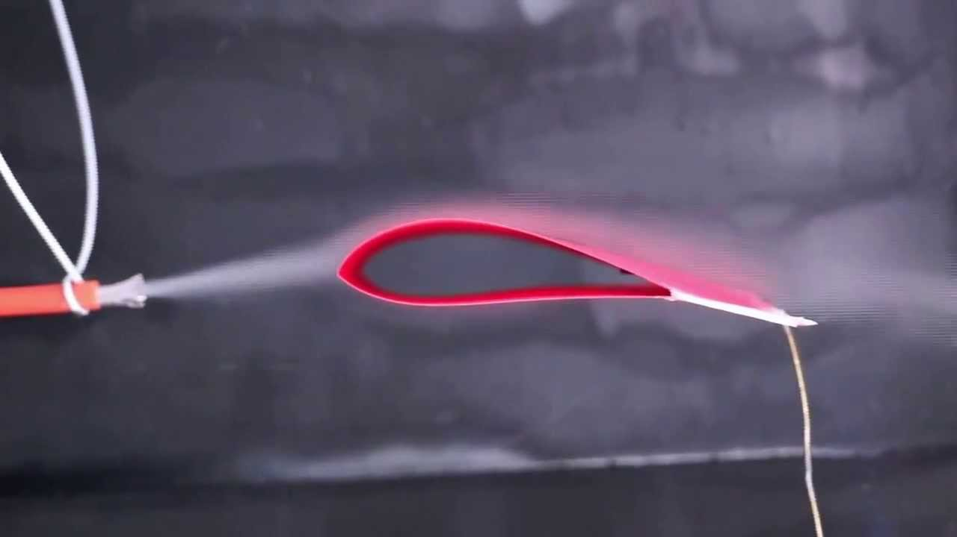
WIND TUNNEL TESTING:
The canard wing which is to be placed in the model is magnified and designed such that the pressure variation along the wing can be calculated.
A wind tunnel( blower type) at a subsonic speed is used to determine the pressure distinction along the airflow.
The canard is then scaled down as per the requirements of the aircraft and fixed.

Slide 14
PROCEDURE:
The canard wing is first designed with the help of the CATIA.
The designed canard is magnified and its performance characteristics are determined in the wind tunnel.
The hardware required for the design, fabrication and control of the model will be brought.
The programming required for the altitude and pressure indication is programmed.
The wings are of delta type and fine tapering is done to reduce drag.

Slide 15
The centre of gravity and aerodynamic centre points are determined and the wings are placed accordingly.
The pressure and the altitude sensors are placed in the fuselage.
The canard wings, main wings and vertical stabilizer are mounted in the fuselage at their determined places as calculated.
The servo motors are mounted on the wings, rudder and fuselage for desired operational controls.
The final fabrication of the model is done for the model and put for operation.

Slide 16
FLOW OF ACTIVITIES:
SL. NO | Nature of work | December | January | February | March
1 | Market survey and purchase of hardware
2 | Wind tunnel testing of canard wing
3 | Fabrication, installation and programming
4 | Final testing

Slide 17
ESTIMATED OUTCOME:
Higher angle of attack up to 15 degree is achieved without much drag and loss of efficiency.
The problem of flow separation at higher angles of attack are avoided with the aid of the canard
The performance characteristics over the canard wing is determined with wind tunnel testing.
The pressure and altitude variation along the course of the flight is sensed.

Slide 18
Thank you

